Slide 1


Social Buzz

Slide 2


Today's agenda
Project recap
Problem
The Analytics team
Process
Insights
Summary

Slide 3

Social Buzz is a fast growing technology unicorn that needs to adapt quickly to its global scale.
Accenture has begun a 3 months POC focusing on these tasks:
An audit of Social Buzz big data practice
Recommendation for successful IPO
Analysis to find Social Buzz’s top 5 most popular categories of content
Project Recap

Slide 4


Problem
Over 100000 post per day
36,500,000 pieces of content per year!
But how to capitalise on it when there is so much?
Analysis to find Social Buzz’s top 5 most popular categories of content.

Slide 5



Andrew Fleming
Chief Technical Architect
The Analytics team
Marcus Rampton
Senior Principle
Jake Sparrow
Data Analyst

Slide 6
Process
1
Data Understanding
2
Data Cleaning
3
Data Modelling
4
Data Analysis
5
Uncover Insights

Slide 7
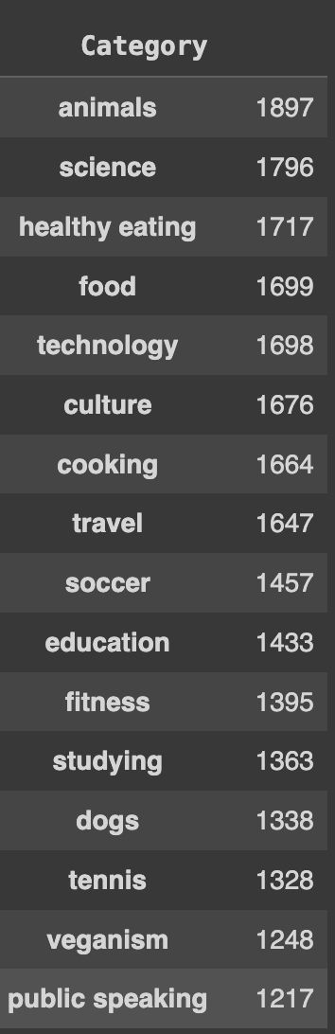
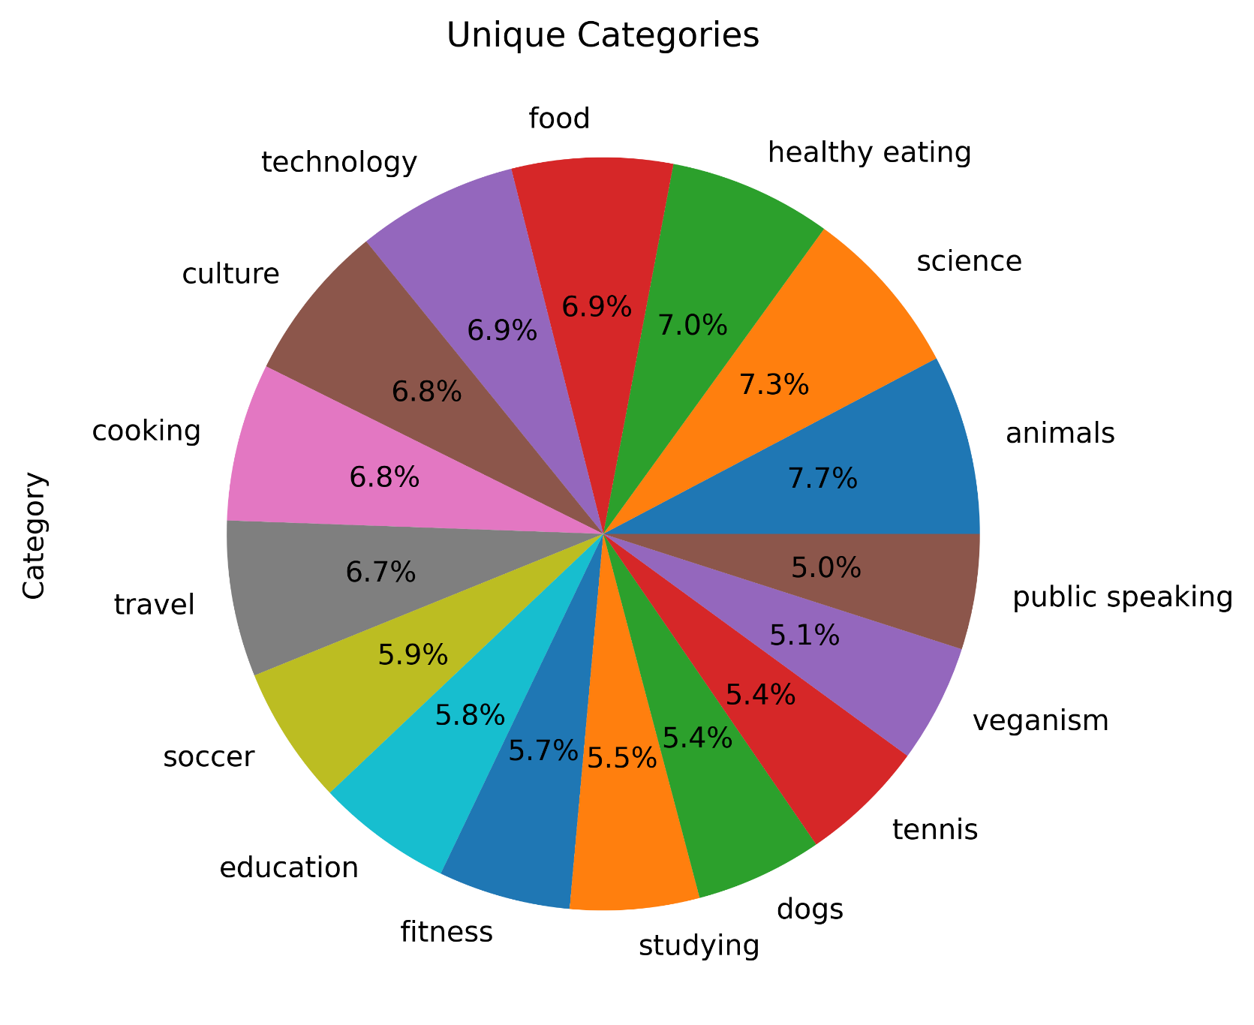
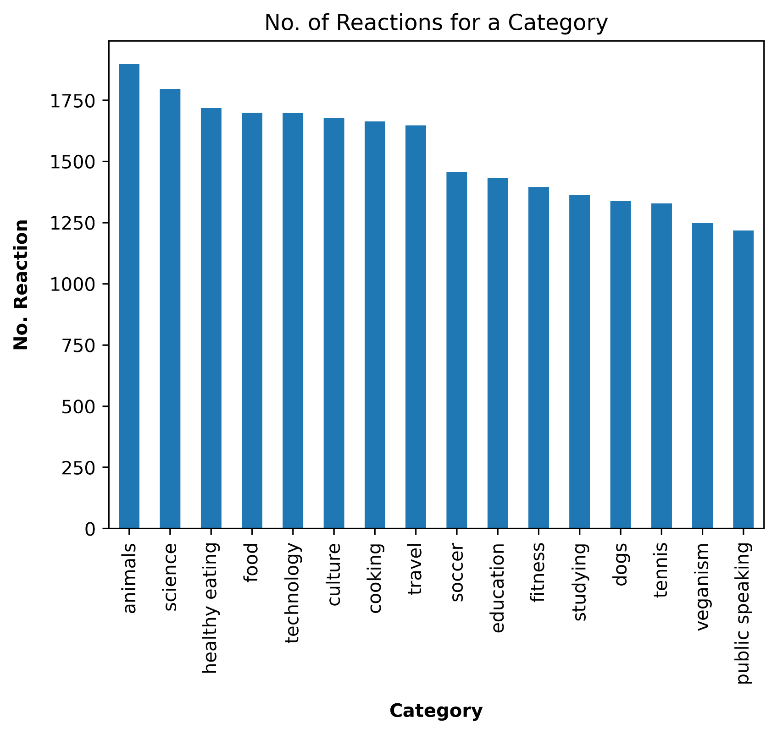
Insights

Slide 8
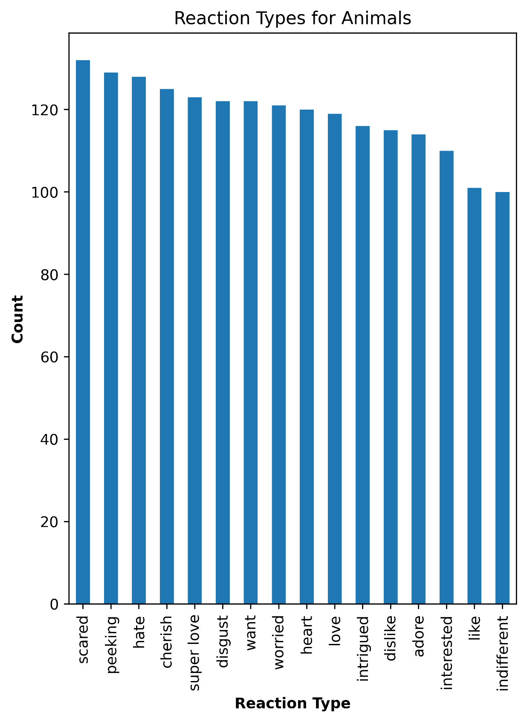
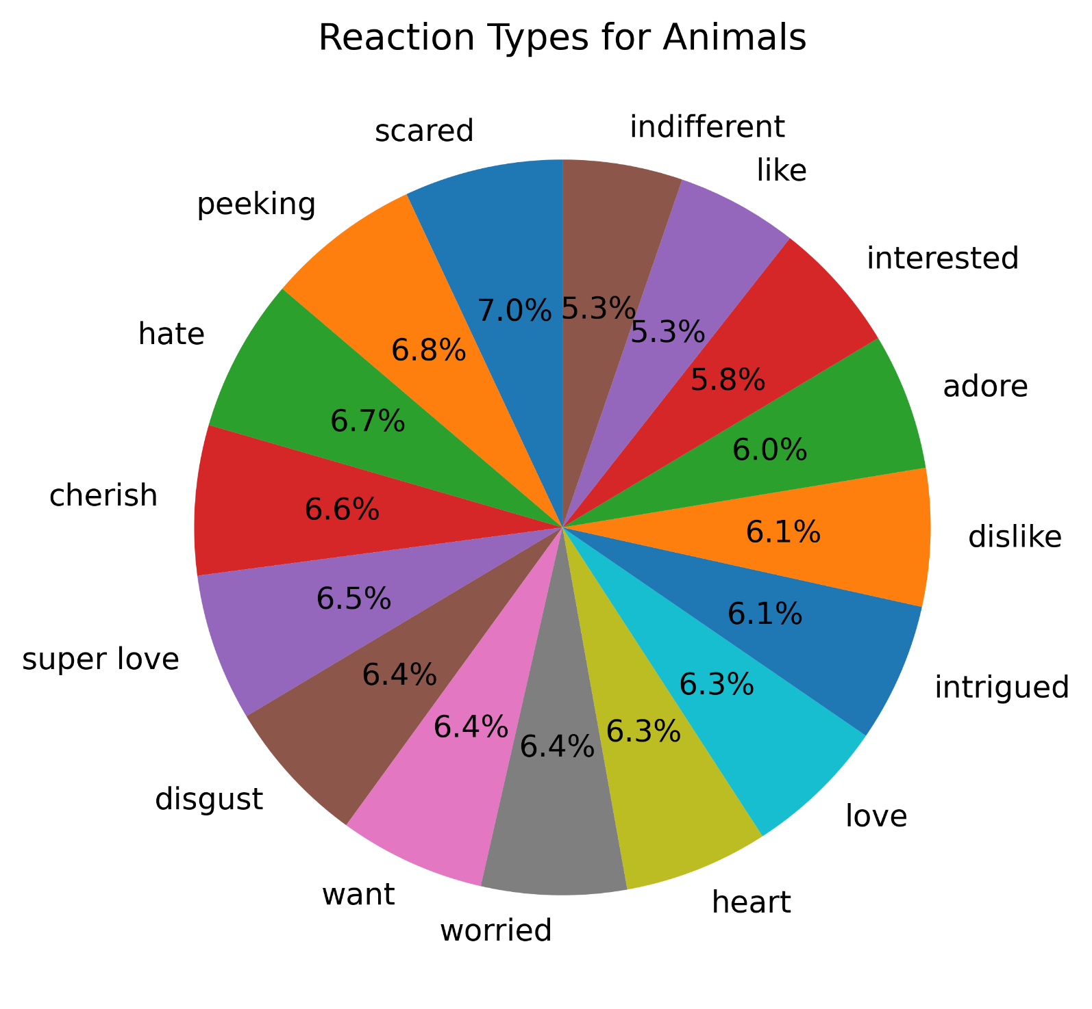
Insight about the most popular category
Most Popular Category : Animals

Slide 9
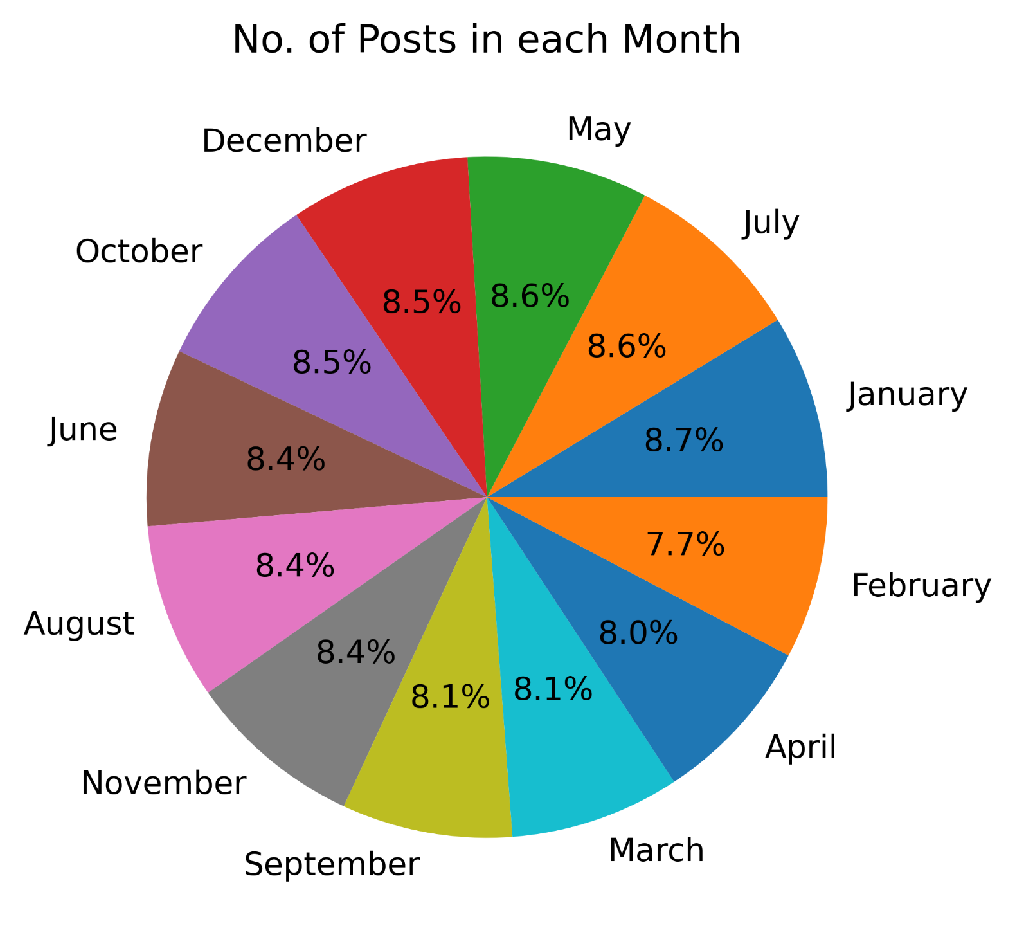
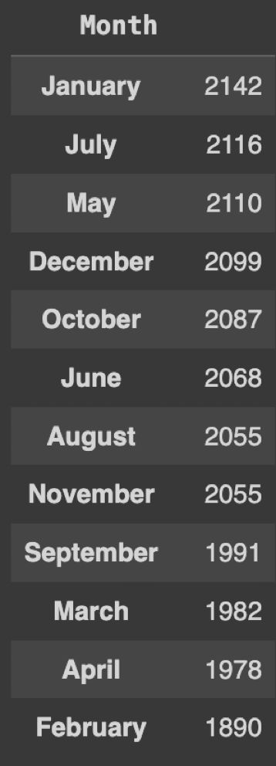
Insight about the Post with Months
Month with most post : January

Slide 10
Summary
The analysis of data revealed 16 unique content categories, with the top five ranked by scores being Animals, Science, Healthy Eating, Food, and Technology. This trend suggests that users are particularly concerned about their health and interested in healthy eating. Additionally, the popularity of Science and Technology indicates a strong interest in technological advancements and developments worldwide.
1
2
Animals emerge as the most popular category among all, indicating strong user engagement with animal-related content. This category garnered the highest number of reactions marked as "scared" and "hate," reflecting negative emotions from a majority of users. However, a significant number also expressed positive reactions such as "superlove" and "cheer," highlighting their affection and care for animals
3
The most content was posted in January, followed by July, May, and December. This is likely because these months are vacation times when students, especially in college and school, have more time to engage and share on social media.

Slide 11

Thank you!
ANY QUESTIONS?

